Slide 1

Paul On His Knees Again
3:14 – 21
Week 20
15 June 2022

Slide 2

Ephesians overview
In the first half of this chapter Paul reminds his readers of God’s grace that had been shown to him regarding the revelation of the “mystery.”
The “mystery” states that the Gentiles would become fellow heirs in Christ with the Jews. Paul felt privileged to preach this “mystery” of salvation among the Gentiles.
Paul knew that what he did was part of God’s eternal purpose in Christ, to make His manifold wisdom known through the body of Christ, the Church. Paul asked his brethren not to be discouraged by any tribulations he experienced on their behalf (1-13).

Slide 3
Ephesians overview
In the second half of the chapter, Paul offers a second prayer for the Ephesians. Paul prays was:
That the Father would strengthen them by the Holy Spirit.
That Christ might dwell in their hearts through faith.
That they be able to know the love of Christ which passes knowledge, and
That they would be filled with all the fullness of God.
Paul concludes this prayer and the chapter by asserting that glory should be given to God in the church by Jesus Christ for all eternity (14-21).

Slide 4

Paul on His Knees … Again!

Slide 5


Slide 6
Ephesians 3:14 – 21
In his last moments in person with the elders of Ephesus, the apostle Paul dropped to his knees and prayed with them (Acts 20:36). Knowing that they would never see him again in this life, they wept loudly, embracing and kissing him (Acts 20:37).
Though they escorted him to the ship as he left Miletus, the leaders from the church in Ephesus would always have the image of Paul kneeling with them in prayer riveted in their memories.
When Paul begins the last segment of the doctrinal part of this letter with the words, “I bow my knees before the Father” (Eph 3:14), several of the older recipients of the letter likely recalled that last emotional meeting with the great apostle.

Slide 7
Ephesians 3:14 – 21
There he knelt, bowing before God, interceding on behalf of the elders of the church in Ephesus. Now, for the second time in his letter to that same church, Paul engages in warfare on his knees.
For a few moments, let’s kneel beside him as he offers up his second prayer for his beloved Christian friends in Ephesus.

Slide 8
Ephesians 3:14 – 15
¹⁴For this reason I kneel before the Father, ¹⁵from whom every family in heaven and on earth derives its name.

Slide 9
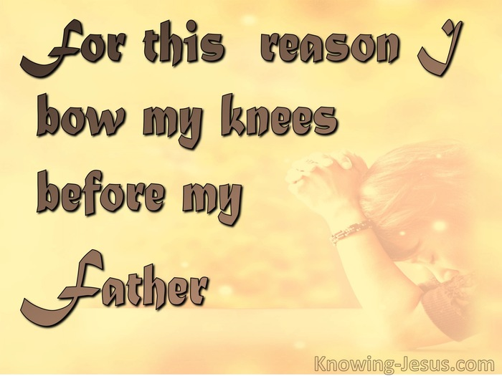

Slide 10
Ephesians 3:14 – 15
However, before we examine the content of Paul’s prayer, we need to ask, “What prompted this prayer, which had been lingering in his heart for some time?” Remember that he almost burst into the prayer in 3:1 when he wrote, “For this reason, I, Paul, the prisoner of Christ Jesus for the sake of you Gentiles . . .” Yet at that point Paul interjected a parenthetical description of the mystery of the gospel, of which he had been made a minister (3:2-12).
He followed this with an exhortation for the Ephesians “not to lose heart” at his tribulations on their behalf (3:13). So, when Paul says a second time, “For this reason” (3:14), he is transitioning from the profound theological truth of the mystery of the church to the vital reality that Paul and his readers have become partakers of this mystery.

Slide 11
Ephesians 3:14 – 15
Paul moves from the general truth to the particular. By 3:14 he has given his readers a reason to avoid discouragement—the mystery once kept hidden has now been revealed . . . to them! Through Paul’s unwavering commitment to preaching the gospel, the Ephesians had become partakers of this new inheritance in Christ, joint heirs with the Jews in the church of Jesus Christ (3:6). In light of these truths expressed in Ephesians 2 and 3, Paul drops to his knees and prays for the Ephesians.
It seems appropriate to make a couple of brief comments about our posture in prayer. Whether you pray standing, kneeling, sitting, or lying on your face, the important point is to pray fervently, consistently, and repeatedly. The attitude of the heart is what counts.

Slide 12
Ephesians 3:14 – 15
There’s nothing magical about our posture. In Paul’s day, however, most people prayed while standing, usually with their hands open in front of them as an act of openness and surrender (Mark 11:25; Luke 18:11; 1Tim 2:8). When first-century Christians dropped to their knees in prayer, they did so to show deep adoration, submissiveness, and urgency.
Now back to Paul’s prayer. Notice first that he address God the Father (3:14). There’s a simple formula Christians should keep in mind when praying. Though the Father, Son, Holy Spirit are each fully God, they are not the same person, but three distinct, inseparable, coeternal, coequal persons. They are the same in divinity, but each has a distinct role or function in relation to creation and redemption.

Slide 13
Ephesians 3:14 – 15
When it comes to proper Christian prayer, we ought to pray to the Father, through the Son, and by the aide of the Holy Spirit. Just as Jesus instructed, when we pray we should address the Father: “Our Father who is in heaven” (Matt 6:9). In fact, the examples of prayer in the New Testament overwhelmingly address God the Father, presenting requests and petitions to Him.
“God the Father” is properly the eternal Father of God the Son, the Lord Jesus Christ, who from eternity-past was ever present with the Father and the Holy Spirit. Paul, however, refers to God simply as “Father,” which may indicate that he has in mind God’s fatherly attitude toward creation.

Slide 14
Ephesians 3:14 – 15
This understanding is confirmed by the fact that Paul further describes “the Father” as the One “from whom the whole family in heaven and earth is named” (3:15).
Paul is referring to the whole family of God—Jews and Gentiles alike—who are all related to Him through Jesus Christ by the unifying work of the Holy Spirit. This has been the whole point of the letter up until now, so this mysterious union of all believers in Christ becomes the basis for Paul’s prayer.

Slide 15
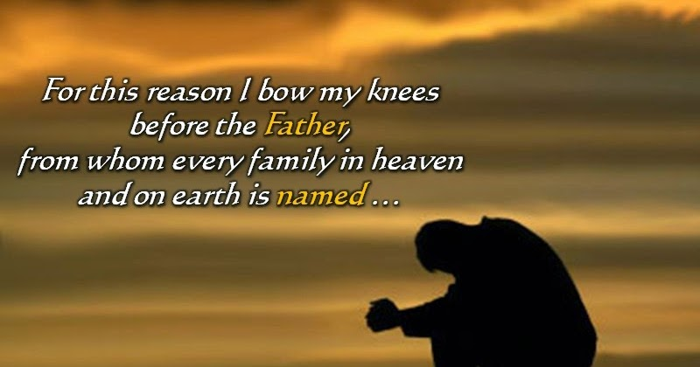

Slide 16
Ephesians 3:16 – 19
¹⁶I pray that out of his glorious riches he may strengthen you with power through his Spirit in your inner being, ¹⁷so that Christ may dwell in your hearts through faith. And I pray that you, being rooted and established in love, ¹⁸may have power, together with all the Lord’s holy people, to grasp how wide and long and high and deep is the love of Christ, ¹⁹and to know this love that surpasses knowledge—that you may be filled to the measure of all the fullness of God.

Slide 17
Ephesians 3:16 – 19
In the prayer itself, Paul petitions God for four things for the Ephesians: that they would . . .
  Be strengthened through the Spirit (3:16-17).
  Be rooted and ground in love (3:17).
  Comprehend the immensity of Christ’s love (3:18-19)
  Be filled to God’s own fullness (3:19).
  In these four requests, Paul covers four dimensions of human needs: psychological, emotional, mental, and spiritual.

Slide 18
Ephesians 3:16 – 19
FIRST – Psychological Dimension: Paul prays that they would be strengthened through the Spirit (3:16-17). Psychologically, we are all in constant danger of becoming discouraged by a loss of inner motivation (3:13). The solution is not found in the latest motivational gimmick or by attending the next “feel good about yourself” seminar. We must turn to the Spirit’s strengthening power.
From His treasure trove of riches, God will bestow on us a strength that wells-up from the depths of our being, which Paul calls “the inner man” (3:16). When the Holy Spirit dwells in us, He mediates to us the real presence of Jesus Christ (3:17). How is this accomplished? By attempting to reform our own lives? By making ourselves more holy?

Slide 19
Ephesians 3:16 – 19
By cleansing our temple so the Spirit will dwell in a clean vessel? No! Paul says Christ dwells in our hearts “through faith”—the same means by which all of God’s grace is mediated to believers.
I can’t exaggerate the psychological impact of this confidence that God the Spirit is dwelling in us. The more we keep Christ at the center of our lives, letting Him shape our attitude, values, choices, decisions, and actions, the more we will be like Him. This transformation from deep within will then affect every other segment of our lives—physical, emotional, mental, and spiritual. Yet it begins in the heart of our being, and it grows by faith alone.

Slide 20
Ephesians 3:16 – 19
SECOND – Emotional Dimension: Paul prays that they would be rooted and grounded in love (3:17). Psalm 1 likens a righteous person who delights in the Law of the Lord to “a tree firmly planted by streams of water” (Ps 1:3). It produces fruit in its season, and it cannot be easily shaken. Like that tree, the life rooted in Christ’s love produces bountiful fruit.
Whereas “rooted” paints an agricultural image, “grounded” comes from the world of construction. Like a building resting on a firm foundation, those whose lives rest on love cannot be shaken (Matt 7:25). As believers tap into and rest upon the unconditional love of God flowing in and through them, they find themselves emotionally balanced and stable.

Slide 21
Ephesians 3:16 – 19
When Paul talks about “love,” he uses the term agape. It includes emotion, but it’s not primarily referring to how we feel about somebody or something. Quite frankly, whether I feel loved has nothing to do with whether I actually am loved. One commentator defines agape as “seeking the highest good in the one loved.”
Yes, there’s emotion felt toward somebody, but the emphasis is on the unconditional commitment. Paul knew that when believers are not simply skipping along the surface of love, they will be able to handle the emotional ups and downs of life. That is, when they are rooted and grounded in unconditional love, they will be agents of peace, unity, and reconciliation rather than strife, discord, and conflict.

Slide 22


Slide 23
Ephesians 3:16 – 19
THIRD – Mental Dimension: Paul prays that they would comprehend the immensity of Christ’s love (3:18-19). Whereas the “love” mentioned in 3:17 referred to the unconditional love flowing from us because of our relationship with Christ, the “love of Christ” in 3:19 refers to Christ’s love shown toward us. So confounding, so unexpected, and so infinite is the love of the One who gave His life for our sins that Paul runs out of images with which to express it.
In fact, Paul prays that the Ephesians would know something that’s beyond knowledge! Paul uses a spatial image to convey the inexpressible and incomprehensible nature of the love of Christ. Its breadth, length, height, and depth are immeasurable.

Slide 24
Ephesians 3:16 – 19
Christ’s love extends boundlessly in every direction, like an infinite universe whose end can never be reached. Swindoll states, “I can’t help but think of the Cross when I read those words:
Broad enough to cover anybody.
Long enough to go beyond any barrier.
High enough to take us all the way to glory and beyond.
Deep enough to touch any need, any sin, or any hurt.
So, addressing the mental dimension of his reader’s being, Paul prays that the believers would grow deeper in their knowledge of God, whose greatness can never be fully grasped, whose love can never be fully understood, and whose glory can never be fully experienced.

Slide 25
Ephesians 3:16 – 19
Paul is not talking here about “head knowledge.” Anybody can believe and confess that God’s love is beyond anything we can imagine. But to experience it—to know it as the recipient of His mercy and grace—that’s something that can’t be understood in a merely intellectual sense.
Like jazz, which is something that’s cannot be dissected, measured, described, and explained, but has to be heard, felt, and experienced. The same is true of the love of Christ but in an infinitely greater sense. Paul prays for the Ephesians’ comprehension because apart from the illumination work of the Spirit, this kind of supernatural knowledge is impossible.

Slide 26
Ephesians 3:16 – 19
FINAL – Spiritual Dimension: Paul prays that they would be filled to God’s own fullness (3:19). Paul continues to set forth one impossibility after another. Unconditional love – unknowable knowledge – and now being filled by an infinite God. Clearly, we finite beings cannot contain the infinite God (2Chr 6:18). So what does Paul mean? He prays that to the fullest extent of our human capacities, we would overflow with God’s strength, love, and knowledge.
We will never be God, nor will we be little “gods.” Those are impossibilities. We can, however, be greater humans than we are—conformed more and more to the image of Jesus Christ as the Spirit floods us with His fullness and we become “partakers of the divine nature” (2Pet 1:4).

Slide 27
Ephesians 3:16 – 19
Paul prayed that the essence or nature of God would fill the Ephesians. When this happens, the spiritual dimension of our being is engaged as we enjoy an intimate fellowship with our great God. That’s a level of intimacy that transcends anything we experience in human relationship.

Slide 28
Ephesians 3:20 – 21
²⁰Now to him who is able to do immeasurably more than all we ask or imagine, according to his power that is at work within us, ²¹to him be glory in the church and in Christ Jesus throughout all generations, for ever and ever! Amen.

Slide 29
Ephesians 3:20 – 21
A great prayer like this deserves a grand benediction—a magnificent conclusion. God’s greatness overwhelmed Paul, just as it overwhelms you and me today. So he turned all of our attention from what we need to become to who God is and what God can do. Compared to what God is able to do for us, our thoughts and prayers appear to be mere musings and ramblings (3:20).
Yet the inexhaustible power of the Holy Spirit works within us, as He mediates His miraculous abilities to us through the church. “Such A God”—and only “Such A God”—is worthy of all glory and honor forever and ever (3:21).

Slide 30


Slide 31
Ephesians 3:20 – 21
Paul’s prayer began with bowing his knee before the Father of all (3:14). It ends with his looking upward and giving all glory to the Father (3:20-21). In between we are encouraged to claim the Spirit’s strength . . . to remember Christ’s love . . . and to seek the Father’s fullness.
Only upon this proper theological foundation concerning the nature of God can we build a stable, practical Christian life worthy of the One who has made us a part of His eternal family.

Slide 32


Slide 33



Slide 34
NEXT CLASS – 22 June 2022
Book of Ephesians
Before next class, read the below verses in the NIV and in one other versions of the Bible, i.e., NKJV, NRSV, KJV, CEV, etc …
Chapter 4:1 – 6
“The Idea of a Worthy Walk”

